Slide 1
Section Summary
Valid Arguments
Inference Rules for Propositional Logic
Using Rules of Inference to Build Arguments
Rules of Inference for Quantified Statements
Building Arguments for Quantified Statements

Slide 2
Revisiting the Socrates Example
We have the two premises:
“All men are mortal.”
“Socrates is a man.”
And the conclusion:
“Socrates is mortal.”
How do we get the conclusion from the premises?

Slide 3
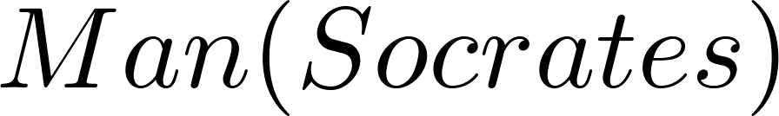
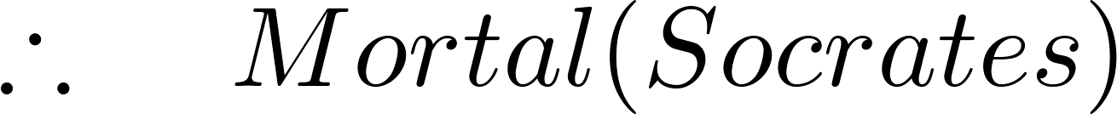
The Argument
We can express the premises (above the line) and the conclusion (below the line) in predicate logic as an argument:
We will see shortly that this is a valid argument.
p | q | p → q
T | T | T
T | F | F
F | T | T
F | F | T

Slide 4
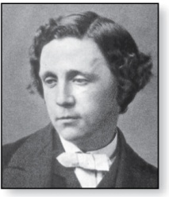
Lewis Carroll Example
p | q | p → q
T | T | T
T | F | F
F | T | T
F | F | T
Charles Lutwidge Dodgson
(AKA Lewis Caroll)
(1832-1898)
The first two are called premises and the third is called the conclusion.
“All lions are fierce.”
“Some lions do not drink coffee.”
“Some fierce creatures do not drink coffee.”
Here is one way to translate these statements to predicate logic. Let P(x), Q(x), and R(x) be the propositional functions “x is a lion,” “x is fierce,” and “x drinks coffee,” respectively.
∀x (P(x)→ Q(x))
∃x (P(x) ∧ ¬R(x))
∃x (Q(x) ∧ ¬R(x))
Later we will see how to prove that the conclusion follows from the premises.

Slide 5
Valid Arguments
We will show how to construct valid arguments in two stages; first for propositional logic and then for predicate logic. The rules of inference are the essential building block in the construction of valid arguments.
Propositional Logic
Inference Rules
Predicate Logic
Inference rules for propositional logic plus additional inference rules to handle variables and quantifiers.

Slide 6
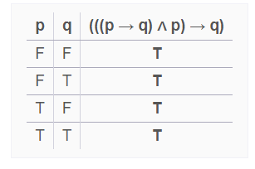
Argument Form
p | q | p → q
T | T | T
T | F | F
F | T | T
F | F | T
p: “You have a current password”
q: “You can log onto the network.”
the argument has the form
p→q (IF p and p→q are true, then q must be true).
p
∴q
the statement ((p → q) ∧ p) → q is a tautology

Slide 7
Valid Arguments (Propositional Logic)
“If you have a current password, then you can log onto the network.”
“You have a current password.”
Therefore, “You can log onto the network.”
Sequence of propositions (argument) is valid; the conclusion must be true when both premise are true.

Slide 8
Argument Form
p | q | p → q
T | T | T
T | F | F
F | T | T
F | F | T
p: ““You have access to the network”
q: “You can change your grade”
the argument has the form
“If you have access to the network, then you can change your grade.”
“You have access to the network.”
∴ “You can change your grade.”
The argument is valid, but if premise is false, we cannot conclude that the conclusion is true.

Slide 9
Arguments in Propositional Logic
A argument in propositional logic is a sequence of propositions. All but the final proposition are called premises. The last statement is the conclusion.
The argument is valid if the premises imply the conclusion. An argument form is an argument that is valid no matter what propositions are substituted into its propositional variables.
If the premises are p₁ ,p₂, …,p_{n} and the conclusion is q then
(p₁ ∧ p₂ ∧ … ∧ p_{n} ) → q is a tautology.
Inference rules are all argument simple argument forms that will be used to construct more complex argument forms.

Slide 10

Rules of Inference for Propositional Logic: Modus Ponendo Ponens
Latin for “the way that affirms by affirming”
Implication elimination
Abbreviated to MP or modus ponens
whenever p → q is true
and p is true,
q must also be true.
p | q | p → q
T | T | T
T | F | F
F | T | T
F | F | T

Slide 11
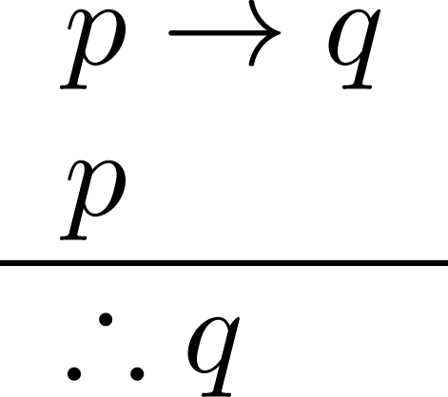
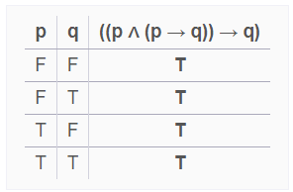
Modus Ponens
p | q | p → q
T | T | T
T | F | F
F | T | T
F | F | T
Corresponding Tautology:
(p ∧ (p →q)) → q
Example:
Let p be “It is snowing.”
Let q be “I will study discrete math.”
“If it is snowing, then I will study discrete math.”
“It is snowing.”
“Therefore , I will study discrete math.”

Slide 12
Modus Ponens
State which rule of inference is the basis of the following argument:
“If it snows today, then we will go skiing”. “It is snowing today”, “therefore we will go skiing”.
Let p be the proposition “It is snowing today” and q the proposition “We will go skiing” Then this argument is of the form
p → q
p
∴q
This is an argument that uses the Modus Ponens rule.

Slide 13

Modus Tollendo Tollens
Latin for "the way that denies by denying"
Denying the consequent
Abbreviated to modus tollens
in every instance in which
p → q is true and q is false,
p must also be false.
p | q | p → q
T | T | T
T | F | F
F | T | T
F | F | T

Slide 14
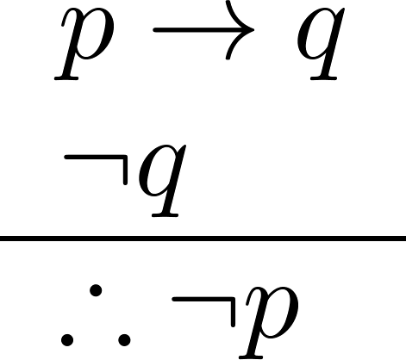
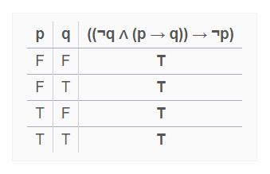
Modus Tollens
p | q | p → q
T | T | T
T | F | F
F | T | T
F | F | T
Corresponding Tautology:
(¬q∧(p →q))→¬p
Example:
Let p be “it is snowing.”
Let q be “I will study discrete math.”
“If it is snowing, then I will study discrete math.”
“I will not study discrete math.”
“Therefore , it is not snowing.”

Slide 15
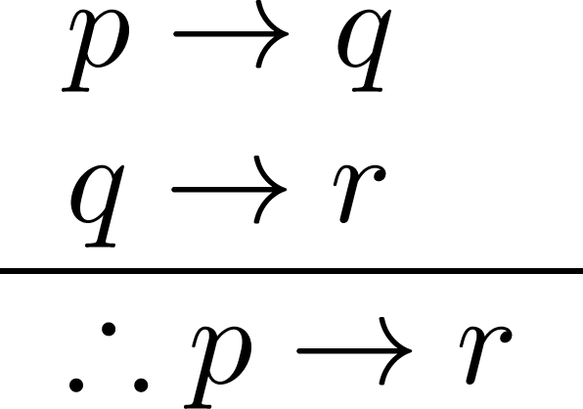
Hypothetical Syllogism
p | q | p → q
T | T | T
T | F | F
F | T | T
F | F | T
Corresponding Tautology:
((p →q) ∧ (q→r))→(p→ r)
Example:
Let p be “it snows.”
Let q be “I will study discrete math.”
Let r be “I will get an A.”
“If it snows, then I will study discrete math.”
“If I study discrete math, I will get an A.”
“Therefore , If it snows, I will get an A.”

Slide 16
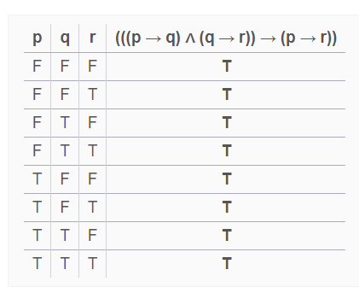

Slide 17
Hypothetical Syllogism
State which rule of inference is used in the argument:
If it rains today, then we will not have a barbecue today. If we do not have a barbecue today, then we will have a barbecue tomorrow. Therefore, if it rains today, then we will have a barbecue tomorrow.
p→q
q→r
∴p→r
Hence, this argument is a hypothetical syllogism.

Slide 18
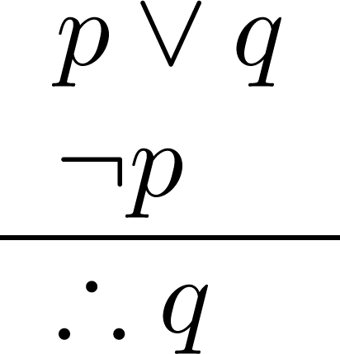
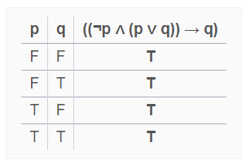
Disjunctive Syllogism
p | q | p → q
T | T | T
T | F | F
F | T | T
F | F | T
Corresponding Tautology:
(¬p∧(p ∨q))→q
Example:
Let p be “I will study discrete math.”
Let q be “I will study English literature.”
“I will study discrete math or I will study English literature.”
“I will not study discrete math.”
“Therefore , I will study English literature.”

Slide 19
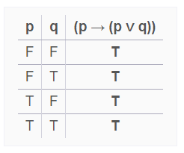
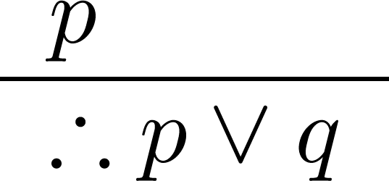
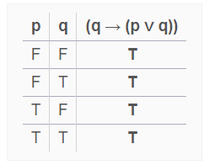
Addition
p | q | p → q
T | T | T
T | F | F
F | T | T
F | F | T
Corresponding Tautology:
p →(p ∨q)
q → (pvq)
Example:
Let p be “I will study discrete math.”
Let q be “I will visit Las Vegas.”
“I will study discrete math.”
“Therefore, I will study discrete math or I will visit
Las Vegas.”

Slide 20
Addition Rule
State which rule of inference is the basis of the following argument:
“It is below freezing now. Therefore, it is either below freezing or raining now.”
Let p be the proposition “It is below freezing now” and q the proposition “It is raining now.” Then this argument is of the form
p
∴p∨q
This is an argument that uses the addition rule.

Slide 21
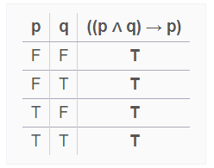
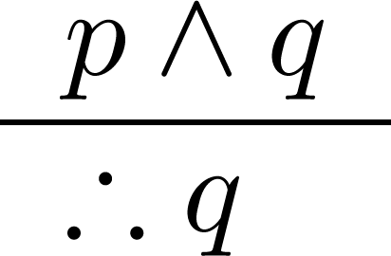
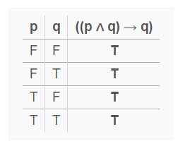
Simplification
p | q | p → q
T | T | T
T | F | F
F | T | T
F | F | T
Corresponding Tautology:
(p∧q) →p
(p ∧q)→q
Example:
Let p be “I will study discrete math.”
Let q be “I will study English literature.”
“I will study discrete math and English literature”
“Therefore, I will study discrete math.”

Slide 22
Simplification Rule
State which rule of inference is the basis of the following argument:
“It is below freezing and raining now. Therefore, it is below freezing now.”
Let p be the proposition “It is below freezing now,” and let q be the proposition “It is raining now.” This argument is of the form
p∧q
∴p
This argument uses the simplification rule.

Slide 23
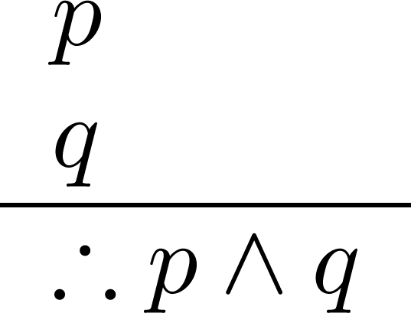
Conjunction
p | q | p → q
T | T | T
T | F | F
F | T | T
F | F | T
Corresponding Tautology:
((p) ∧ (q)) →(p ∧ q)
Example:
Let p be “I will study discrete math.”
Let q be “I will study English literature.”
“I will study discrete math.”
“I will study English literature.”
“Therefore, I will study discrete math and I will study English literature.”

Slide 24
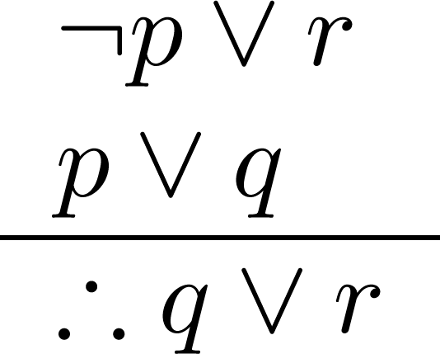
Resolution
p | q | p → q
T | T | T
T | F | F
F | T | T
F | F | T
Resolution plays an important role in AI and is used in Prolog.
Corresponding Tautology:
((¬p ∨ r ) ∧ (p ∨ q)) →(q ∨ r)
Example:
Let p be “I will study discrete math.”
Let r be “I will study English literature.”
Let q be “I will study databases.”
“I will not study discrete math or I will study English literature.”
“I will study discrete math or I will study databases.”
“Therefore, I will study databases or I will English literature.”

Slide 25
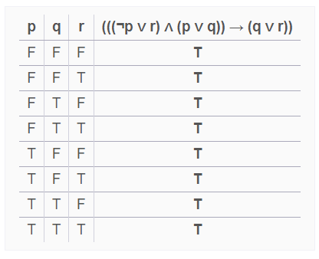

Slide 26

Using the Rules of Inference to Build Valid Arguments
A valid argument is a sequence of statements. Each statement is either a premise or follows from previous statements by rules of inference. The last statement is called conclusion.
A valid argument takes the following form:
S₁
S₂
.
.
.
S_{n}
C
p | q | p → q
T | T | T
T | F | F
F | T | T
F | F | T

Slide 27
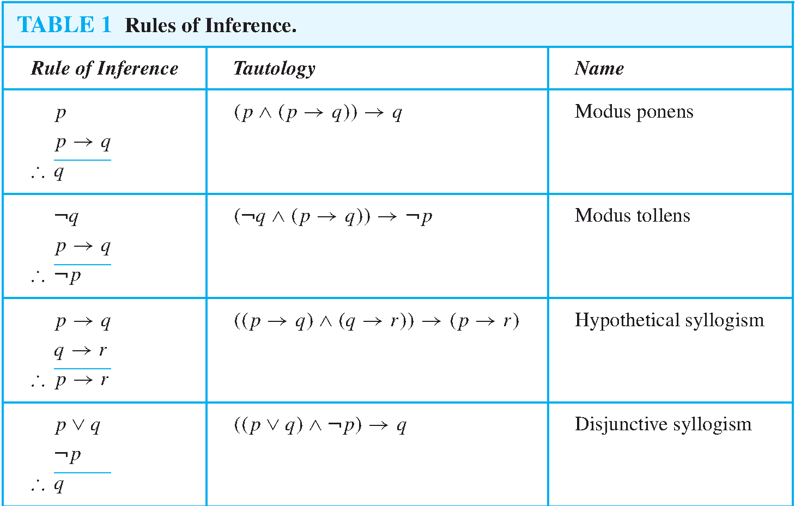

Slide 28
